Slide 1






MSc Dissertation
Dr Thalita Vergilio
t.vergilio@leedsbeckett.ac.uk

Slide 2
Part 1: Introduction
Introduction: what is this module about?

Slide 3

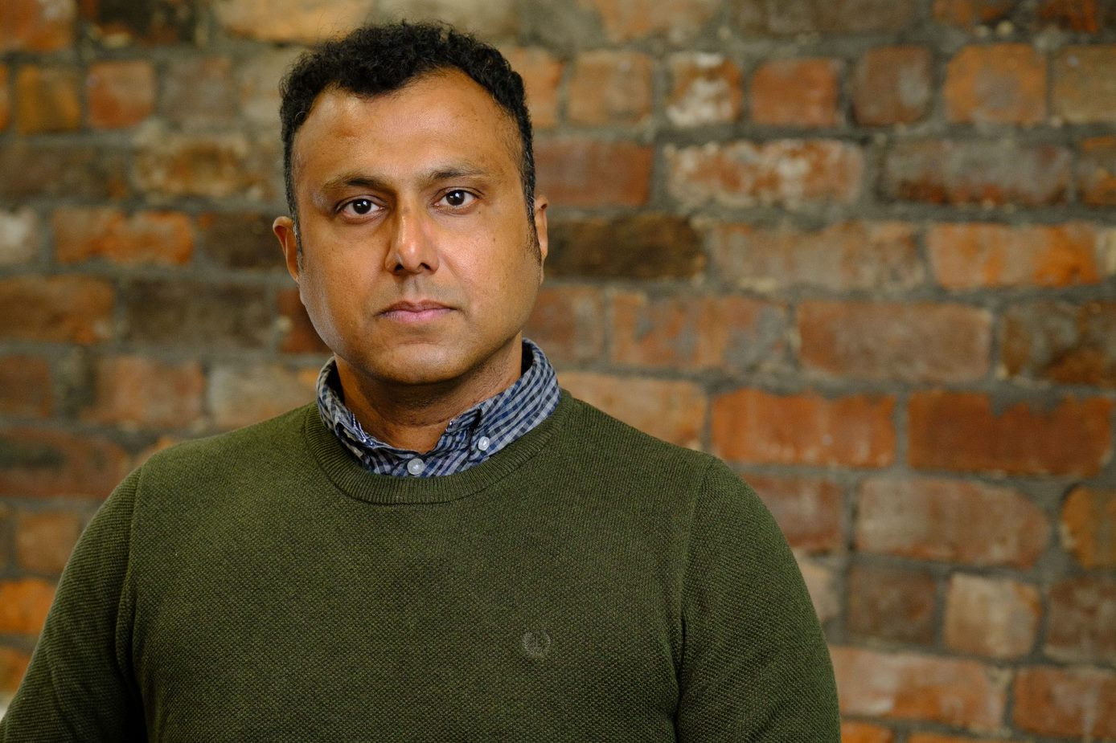





Module Teaching Staff
Supervisors

Slide 4
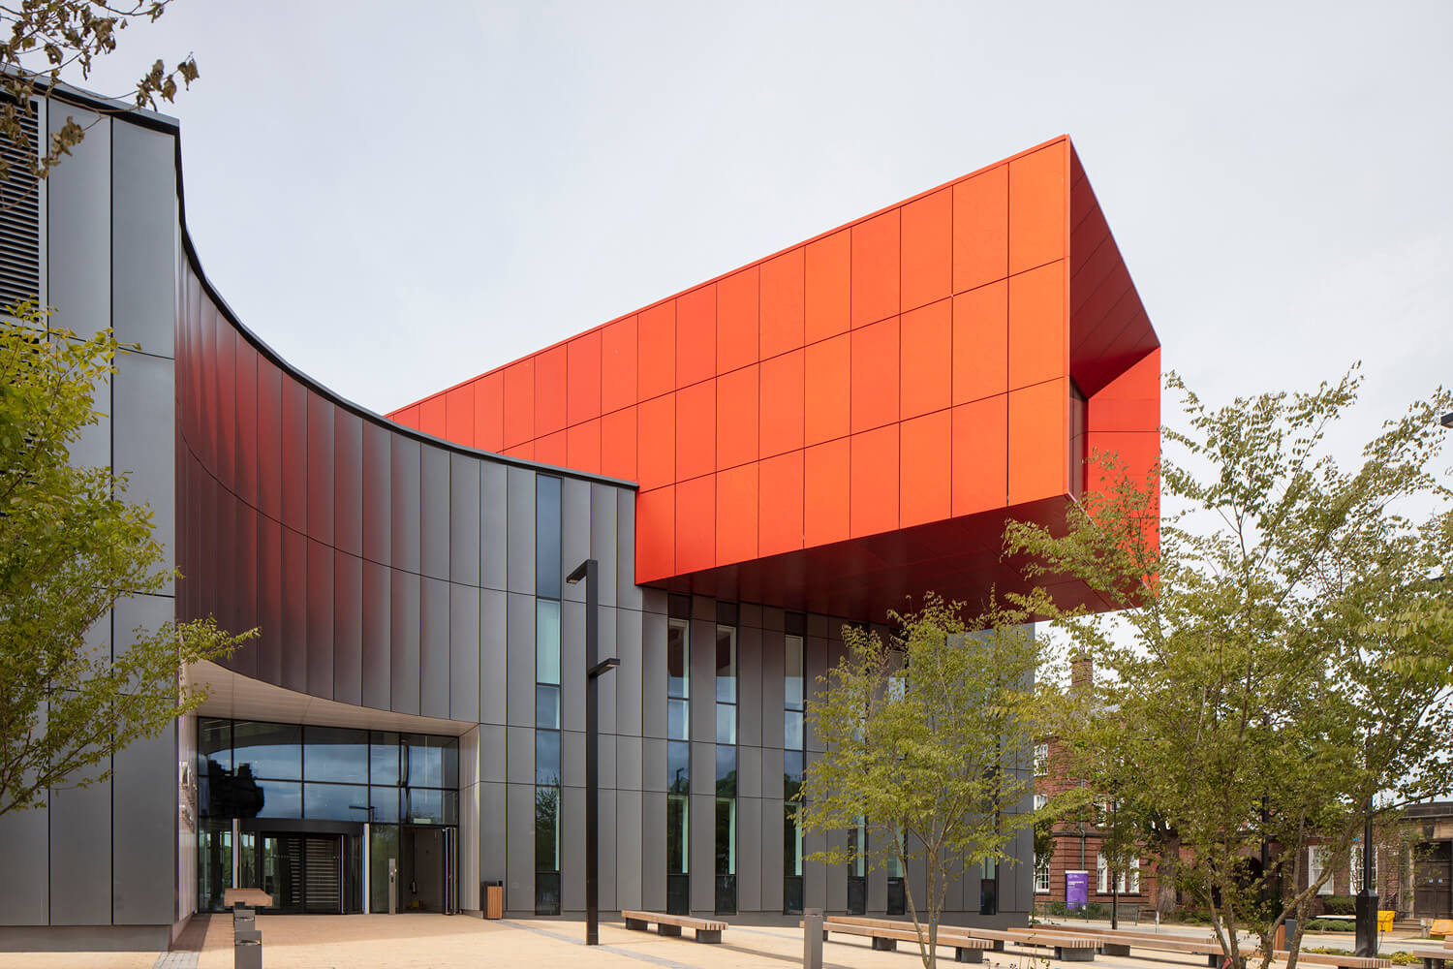
Introduction
The Dissertation is a core module for all awards
You CANNOT get your MSc without completing it!
This module is worth 60 credits at level 7
No requirement for uniqueness, but the project must be sufficiently challenging

Slide 5
Dissertation Timeline
08/03
18/03
Topic choices due
Topics available to students
29/03
Supervisor allocated
17/05
Proposal due
14/06
Draft chapter due
06/09
Dissertation due
As soon as your proposal has been approved by your supervisor, you can start working on your research ethics application.

Slide 6

Introduction
Start thinking about your MSc project:
What were your strengths during your BSc?
Do you have any relevant work experience?
What have you learned in your current program of study?
Consider your future career plans:
Higher education (PhD)?
Industry?

Slide 7
Module Aim and Objectives
A demonstration of the student's ability to undertake and produce a substantial piece of work to a professional standard.
Equal emphasis on academic skills (e.g. investigation, analysis and communication) & professional skills (e.g. planning, design and programming).
Integrate elements from the chosen program of study.
Demonstrate competence in a variety of tasks that are relevant to the chosen award.

Slide 8
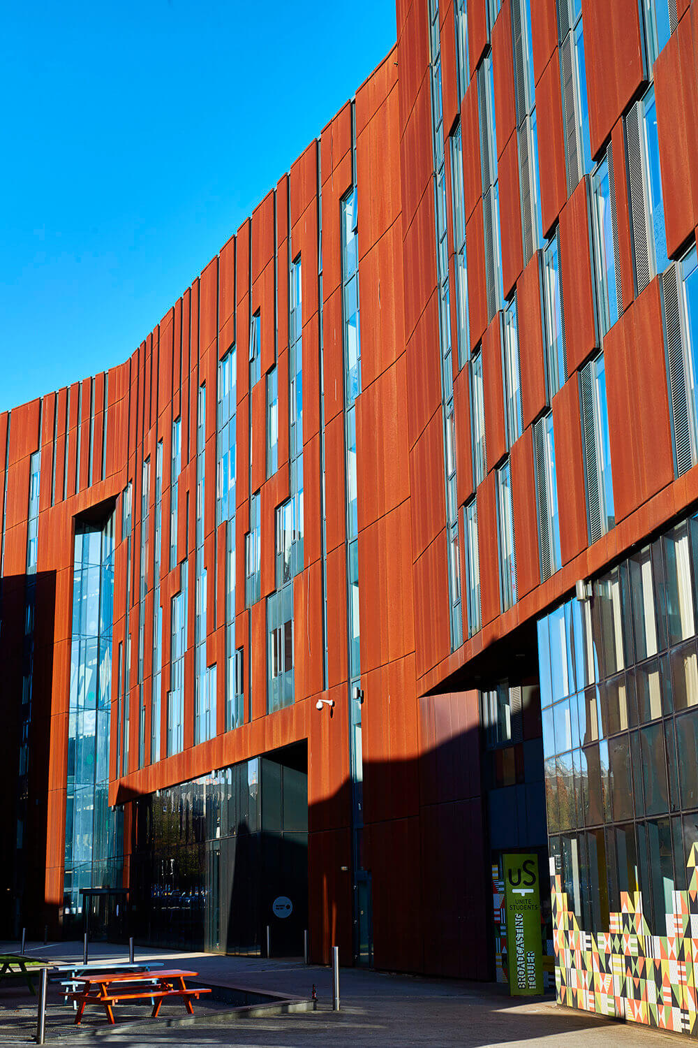

Roles
Q: Who is responsible for your project?
a) your supervisor
b) the module leader
c) you, the student
Please understand that all deliverables from your project must be your own work and not previously submitted for assessment.

Slide 9
Your Supervisory Team
Your supervisor is also your personal tutor.
They will guide you through the project academically as well as provide pastoral care and coaching. Your primary contact will always be the first supervisor.
You will be assigned a second assessor.
They help your supervisor at key stages of the project such as marking your assessment components, giving recommendations, and asking questions in the live Q&A.

Slide 10
Supervision Process
Student Perspective
Phase 1
Phase 2
Phase 3
Define aim and objectives
Discuss methodology
Prepare and submit proposal
Discuss feedback on proposal
Discuss research around the topic
Act on feedback received
Apply for research ethics
Start working on proposed project (experiments or research)
Discuss feedback on draft chapter
Act on feedback received
Finish experiments or research
Write remaining chapters
Prepare and submit a draft chapter (methodology or lit. review)
Submit for plagiarism check
Act on Turnitin report
Submit final
28/05/24
Independent Work
Low
Medium
High
30/06/24
04/09/24

Slide 11
Supervision Meetings
The happy path
Phase 1
Phase 2
Phase 3
29th April – 5th May
5th May – 16th May
10th April – 29 April
20th May – 1st June
1st June– 12th June
20th June – 15 July
Finish experiments or research
Write remaining chapters
Meet to discuss draft chapter structure (methodology or lit. review)
Submit for plagiarism check
Act on Turnitin report
Submit final
Meet to discuss research around chosen area, agree on topic and scope, and set expectations for supervision
Meet to agree on aim and objectives
Meet to discuss related work, methodology choice, and proposal structure
Meet to discuss proposal work so far and to ask/answer questions prior to submission
Meet to discuss feedback on proposal, changes needed, and research ethics application
Work in progress update (experiments or research)
Meet to discuss feedback on draft chapter, clarify any changes needed
Agree on minimum requirements for a pass and plan outstanding work
Submit Proposal 17/05/24
Independent Work
Low
Medium
High
Submit Draft Chapter 14/06/24
Submit Dissertation 06/09/24

Slide 12
Supervision Process
Supervisor Perspective
Phase 1
Phase 2
Phase 3
Define aim and objectives
Discuss methodology
Prepare and submit proposal
Discuss feedback on proposal
Discuss research around the topic
Act on feedback received
Apply for research ethics
Start working on proposed project (experiments or research)
Discuss feedback on draft chapter
Act on feedback received
Finish experiments or research
Write remaining chapters
Prepare and submit a draft chapter (methodology or lit. review)
Submit for plagiarism check
Act on Turnitin report
Submit final
17/05/24
Supervisor Involvement
High
Medium
Low
14/06/24
06/09/24

Slide 13
Supervision Expectations
An academic member of staff is allocated time to meet you regularly as your supervisor (roughly twice a month).
You are responsible for organising these meetings.
Please set the agenda in advance and come prepared.
Please ask your supervisor about periods of annual leave and book your meetings around them.
Please prepare minutes after each meeting, e-mail them to your supervisor, and include them as appendices in your dissertation.

Slide 14

Academic Integrity
The university takes academic integrity very seriously.
Ensure you upload the dissertation a few days before the deadline to give you plenty of time to obtain a similarity report and make the necessary changes.
Suspected plagiarism will be investigated and could lead to a mark of zero, and the case reported at School level.
Suspected ghost writing will be investigated at University level and could lead to you being expelled.

Slide 15
If you are struggling…
Speak to your supervisor at the earliest opportunity – they are there to help you.
Consider applying for an extension.
Consider applying for mitigation/deferral.
Submit late and take a penalty.
Submit what you have, or submit nothing, and take the opportunity for reassessment (capped).
Do not attempt to plagiarise or submit work which is not your own, this could get you in serious trouble and lead to failure of your entire degree (or worse).

Slide 16
Dissertation Topics
A list of research topics have been made available on the VLE. Use the google-form to make three selections.
You may choose a listed topic, or propose your own.
We will do our best to allocate you to the supervisor who proposed your topic. However, limits to staff allocation quotas/availability mean this is not always possible.
Note: if proposing your own topic, you must have already discussed your idea with a potential supervisor obtained their approval.

Slide 17

Topic Examples
MSc Information and Technology (MSCIT)
MSc Data Science (MDATS)
Machine learning-based dementia prediction
Data visualisation dashboard for Covid-19 taskforce
An investigation into smart electricity meters and their applications
MSc Cyber Security & Digital Forensics (MCSDF)
MSc Cyber Security (MCYBS)
To investigate use of tracking devices (wearables) for a digital forensics examination
The design and implementation of an attack-defend CTF scenario
MSc Advanced Computer Science (MADCS)
Automated generation of functional test for REST APIs

Slide 18
Part 2: Assessment Overview
Introduction to formative and summative assessments
Notes:
Feedback from the first session.
A note on reassessment, visa renewal deadlines and ghost writing.
If you must pass the first time around, it is paramount that you submit both formative components by the dates shown.
You should arrange a meeting with your supervisor to discuss feedback and work on a bullet-point list of CLEAR, OBJECTIVE actions to ensure the project meets the requirements to pass first time.
I will chase supervisors to do this. But you must do your part and make the submissions.

Slide 19
How do I pass the module?
Recorded Presentation
Dissertation
Research Ethics
Live Q&A
Required to pass the module
Before 16/09/2024
Must be uploaded to the VLE by 06/09/24

Slide 20
Graded Assessment
20%
80%
Presentation + Q&A
Dissertation
Your grade for this module is based on two assessment components:

Slide 21
Formative Assessment
Formative assessment is for feedback only. You will not be marked, and the components do not count towards your final grade.
There are two pieces of formative assessment in this module:
Proposal
Draft Chapter
Proposal

Slide 22
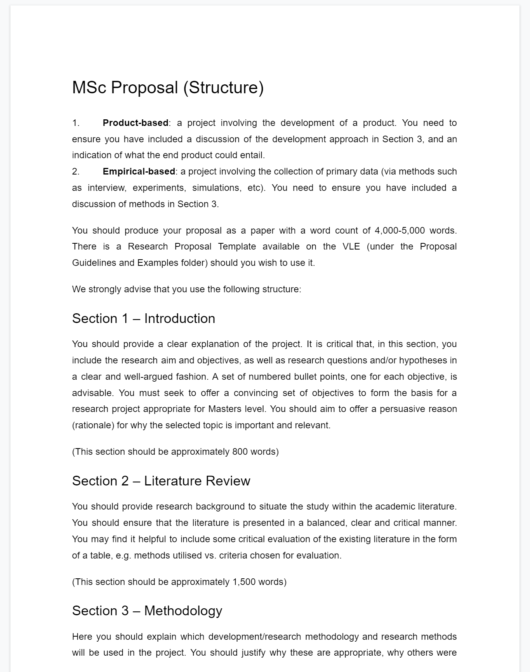
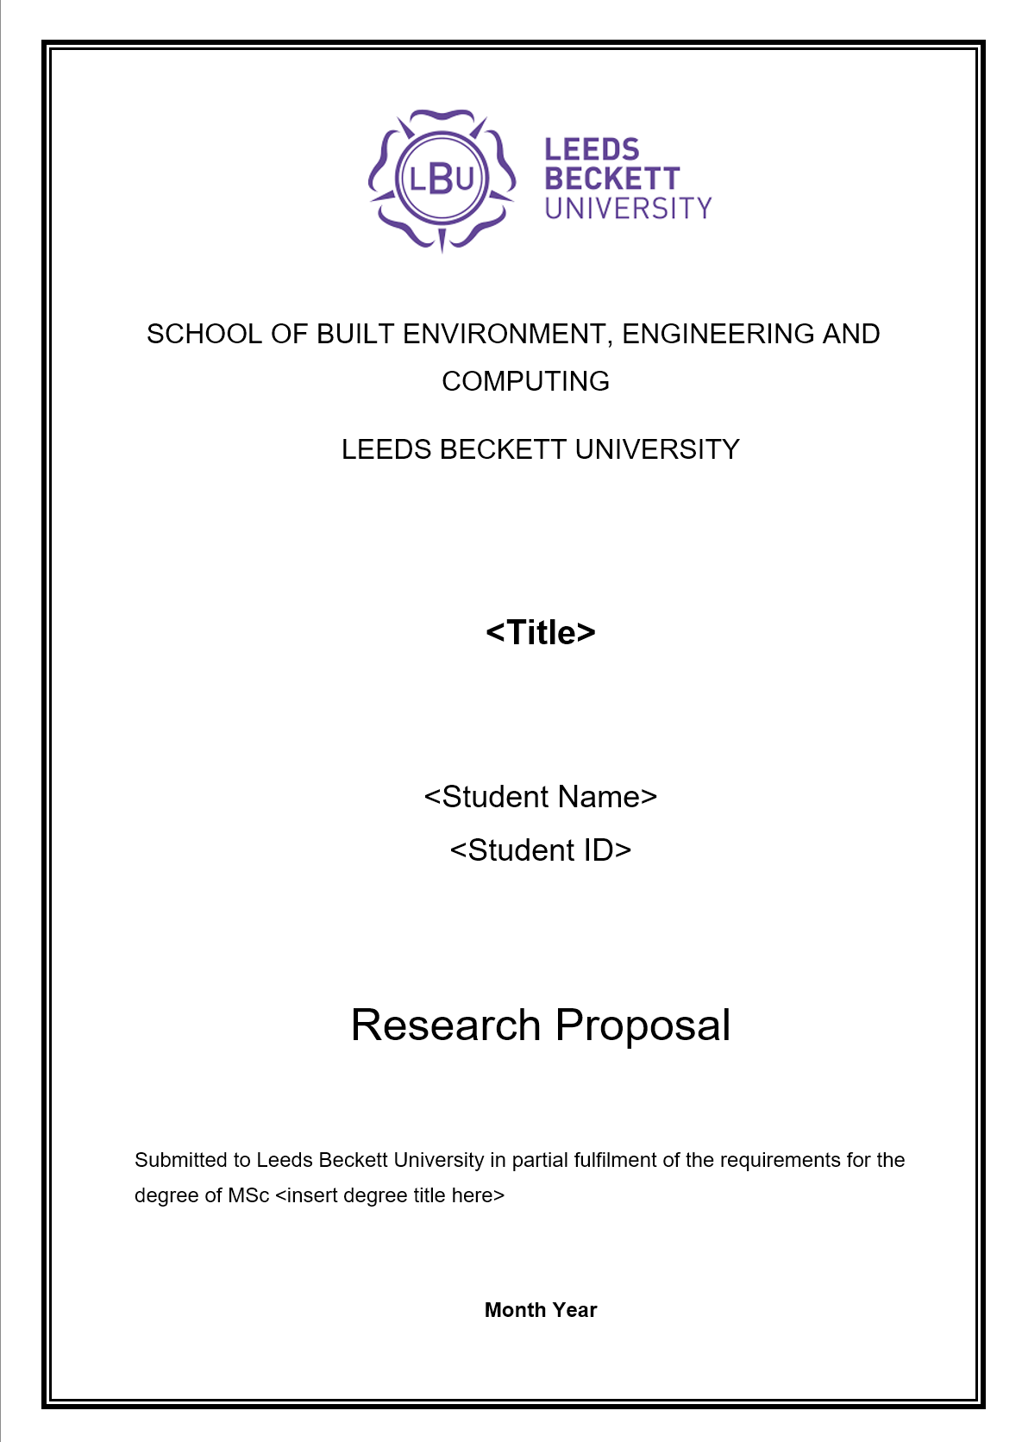
Proposal
You must submit an academic proposal specifying the work you intend to carry out.
Due: 17th May 2024.
Word count: 2,000-3,000 words.

Slide 23
Draft Chapter
You may submit one draft chapter to your supervisor for feedback.
Due: 14 June 2024.
Must be either the Literature Review or the Methodology.
Feedback will only be provided once. There is no provision to go back and forth.

Slide 24
Part 3: Assessment Details

Slide 25
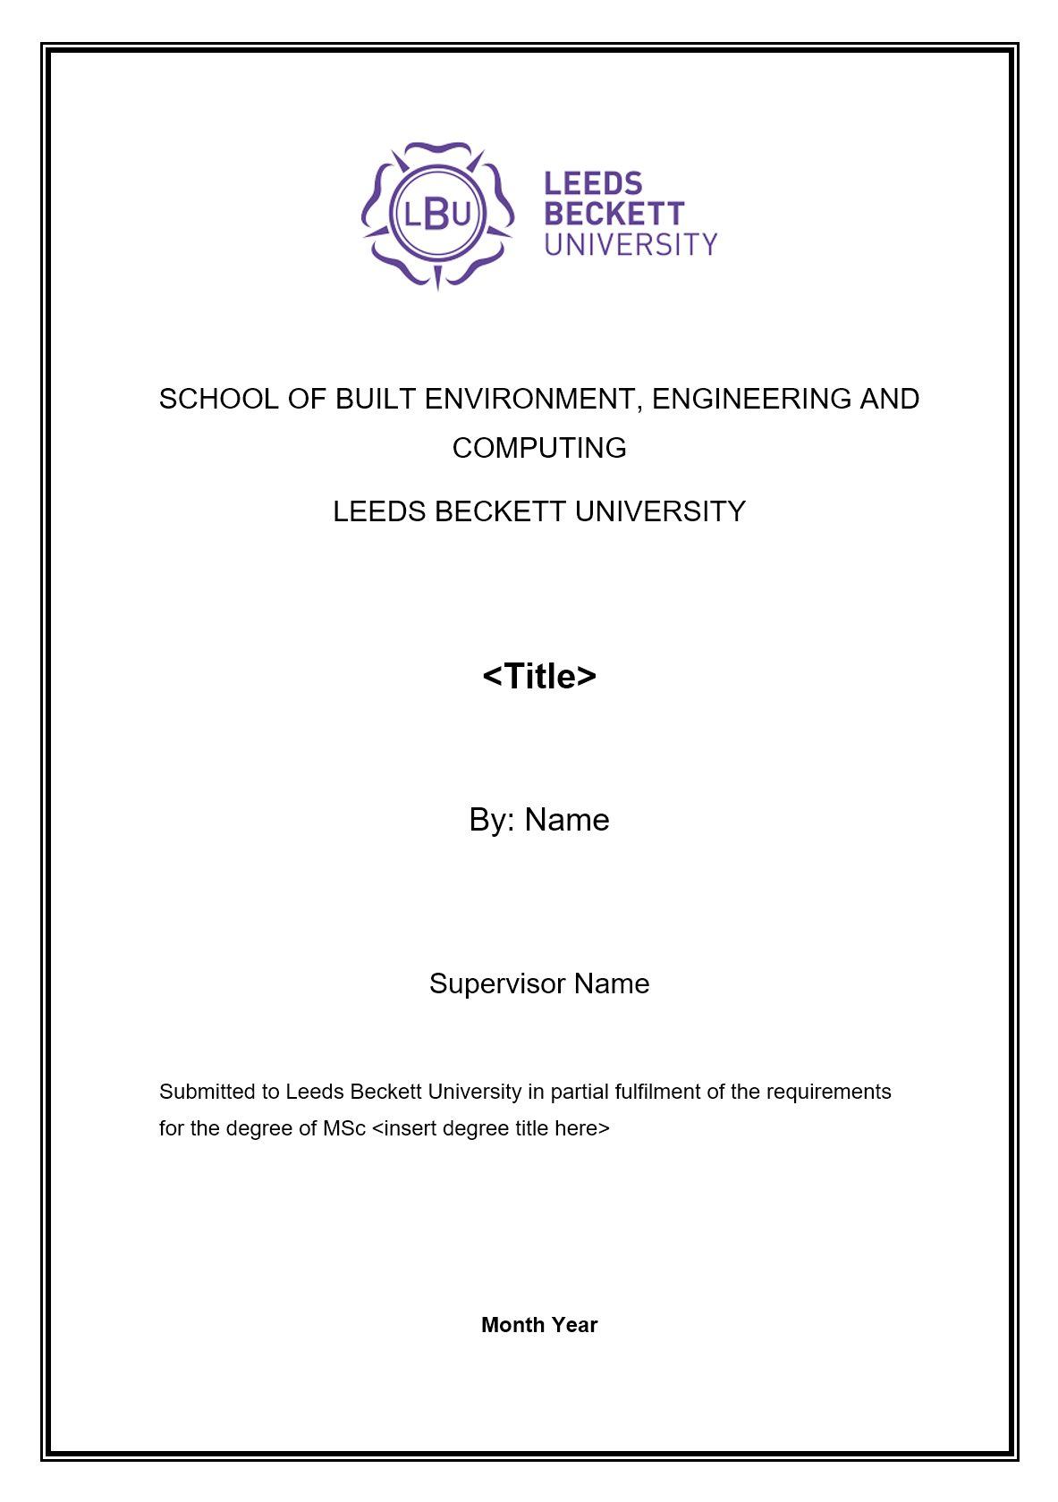
Dissertation Types
We accept two types of dissertation project:
A project based around a product.
A project based around an empirical study.
Type | Word Count | Deliverables | Other Requirements
Product | 10,000–15,000 words | Product + Dissertation | Must demo the product to supervisors before submission.
Empirical | 15,000-20,000 words | Dissertation | Observations from data analytics, experiments, simulation or emulation.
Exclusion of Literature Review-only Dissertations: BCS Accreditation standards explicitly stipulate that dissertations solely based on literature review activities and/or user/market surveys are not acceptable within the scope of this module. Instead, our approach emphasises the importance of practical work and tangible outcomes to ensure that students gain valuable real-world experience.

Slide 26

Recorded Presentation
You must record a presentation outlining the rationale and key findings. This will also include a technical demonstration
The presentation should be between 10 to 15 minutes in length and MUST show your person (face).
You must upload your presentation to YouTube and submit the URL of your video on the upload link provided in the VLE.

Slide 27

Live Q&A
You are expected to arrange a live Q&A session with both your supervisor and your second marker.
This may take place online or on-site, depending on the supervisory team's preference and the nature of your specific project.
The Q&A should last approximately 15-20 minutes.
You may be asked to demo the product.
The Q&A is like a mini PhD viva where you are expected to defend your work, come prepared!

Slide 28

Questions?

